Slide 1
Graphs

Slide 2
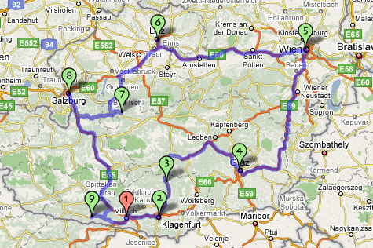
Example

Slide 3
Example (cont.)
849
PVD
1843
ORD
142
SFO
802
LGA
337
1743
1387
HNL
2555
1099
LAX
1233
DFW
1120
MIA

Slide 4
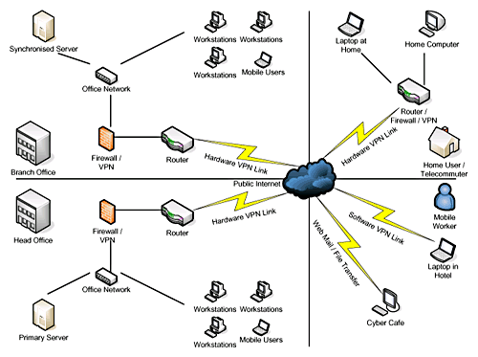
Example (cont.)

Slide 5
Graphs
A graph is a pair (V, E), where
V is a set of nodes, called vertices
E is a collection of pairs of vertices, called edges
Vertices and edges are positions and store elements
Example:
A vertex represents an airport and stores the three-letter airport code
An edge represents a flight route between two airports and stores the mileage of the route
849
PVD
1843
ORD
142
SFO
802
LGA
337
1743
1387
HNL
2555
1099
LAX
1233
DFW
1120
MIA

Slide 6
Applications
Electronic circuits
Printed circuit board
Integrated circuit
Transportation networks
Highway network
Flight network
Computer networks
Local area network
Internet
Web
Databases
Entity-relationship diagram

Slide 7
Edge Types
Directed edge
ordered pair of vertices (u,v)
first vertex u is the origin
second vertex v is the destination
e.g., a flight
Undirected edge
unordered pair of vertices (u,v)
e.g., a flight route
Directed graph
all the edges are directed
e.g., route network
Undirected graph
all the edges are undirected
e.g., flight network
flight
AA 1206
ORD
PVD
849
miles
ORD
PVD

Slide 8
Terminology
End vertices (or endpoints) of an edge
U and V are the endpoints of a
Edges incident on a vertex
a, d, and b are incident on V
Adjacent vertices
U and V are adjacent
Degree of a vertex
X has degree 5
Parallel edges
h and i are parallel edges
Self-loop
j is a self-loop
V
a
b
h
j
U
d
X
Z
c
e
i
W
g
f
Y

Slide 9
Terminology (cont.)
Path
sequence of alternating vertices and edges
begins with a vertex
ends with a vertex
each edge is preceded and followed by its endpoints
Simple path
path such that all its vertices and edges are distinct
Examples
P₁=(V,b,X,h,Z) is a simple path
P₂=(U,c,W,e,X,g,Y,f,W,d,V) is a path that is not simple
V
a
b
P₁
d
U
X
Z
P₂
h
c
e
W
g
f
Y

Slide 10
Terminology (cont.)
Cycle
circular sequence of alternating vertices and edges
each edge is preceded and followed by its endpoints
Simple cycle
cycle such that all its vertices and edges are distinct
Examples
C₁=(V,b,X,g,Y,f,W,c,U,a,↵) is a simple cycle
C₂=(U,c,W,e,X,g,Y,f,W,d,V,a,↵) is a cycle that is not simple
V
a
b
d
U
X
Z
C₂
h
e
C₁
c
W
g
f
Y

Slide 11
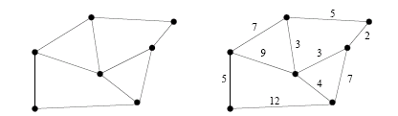
Weighted and unweighted graphs
G = (V, E) is a weighted graph if each edge (u,v)∈E is assigned a weight
Example of weighted graph?
Example of unweighted graph?

Slide 12

Graph Presentation
G = (V, E); V = {0, 1,…, n-1}
Present a graph by an adjacency matrix
A[u][v] = 1 if (u,v) ∈ E
A[u][v] = 0 Otherwise
 | 0 | 1 | 2 | 3 | 4
0 | 0 | 1 | 1 | 0 | 0
1 | 0 | 0 | 1 | 0 | 1
2 | 0 | 0 | 0 | 1 | 1
3 | 1 | 0 | 0 | 0 | 0
4 | 0 | 0 | 0 | 1 | 0

Slide 13
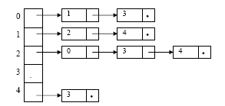
Graph presentation
G = (V, E); V = {0, 1,…, n-1}
Present a graph by edge list structure

Slide 14
Subgraphs
A subgraph S of a graph G is a graph such that
The vertices of S are a subset of the vertices of G
The edges of S are a subset of the edges of G
A spanning subgraph of G is a subgraph that contains all the vertices of G
Subgraph
Spanning subgraph

Slide 15
Connectivity
A graph is connected if there is a path between every pair of vertices
A connected component of a graph G is a maximal connected subgraph of G
Connected graph
Non connected graph with two connected components

Slide 16
Trees and Forests
A (free) tree is an undirected graph T such that
T is connected
T has no cycles
This definition of tree is different from the one of a rooted tree
A forest is an undirected graph without cycles
The connected components of a forest are trees
Tree
Forest

Slide 17
Spanning Trees and Forests
A spanning tree of a connected graph is a spanning subgraph that is a tree
A spanning tree is not unique unless the graph is a tree
Spanning trees have applications to the design of communication networks
A spanning forest of a graph is a spanning subgraph that is a forest
Graph
Spanning tree

Slide 18
Breadth-First Search
L₀
A
L₁
B
C
D
L₂
E
F

Slide 19
Breadth-First Search
Breadth-first search (BFS) is a general technique for traversing a graph
A BFS traversal of a graph G
Visits all the vertices and edges of G
Determines whether G is connected
Computes the connected components of G
Computes a spanning forest of G
BFS on a graph with n vertices and m edges takes O(n + m ) time
BFS can be further extended to solve other graph problems
Find and report a path with the minimum number of edges between two given vertices
Find a simple cycle, if there is one

Slide 20
Breadth first search
Problem: Visit all vertices of a graph with a rule:
“if vertex u is visited before vertex v, then adjacent vertices of u will be visited before adjacent vertices of v”

Slide 21
Breadth first search
BreadthFirstSearch (G, v) {
(1) Set a queue Q empty;
(3) enqueue v onto Q;
(2) mark v as visited;
(4) while (Q not empty) {
(5) w = dequeue Q;
(6) for (each u adjacent w)
(7) if ( u not visited) {
(8) visit and enqueue u onto Q;
(9) mark u as visited
}
}

Slide 22
Breadth first search
// Travel on G=(V, E) by BFS
BreadthFirstSearch_traversal (G) {
(10) for (each v ∈V)
(11) mark v as unvisited;
(12) for (each v ∈V)
(13) if (v not visited)
(14) BreadthFirstSearch(v);
}

Slide 23
Depth-First Search
Depth-first search (DFS) is a general technique for traversing a graph
A DFS traversal of a graph G
Visits all the vertices and edges of G
Determines whether G is connected
Computes the connected components of G
Computes a spanning forest of G
DFS on a graph with n vertices and m edges takes O(n + m ) time
DFS can be further extended to solve other graph problems
Find and report a path between two given vertices
Find a cycle in the graph
Depth-first search is to graphs what Euler tour is to binary trees

Slide 24
Depth first search
//Depth first search from vertex v
DepthFirstSearch (v) {
for (each u adjacent v)
if (u not visited) {
visit and mark u as visited DepthFirstSearch (u)
}
}

Slide 25
Depth first search
//Travel on G=(V, E) by DFS
DepthFirstSearch_traversal (G) {
(10) for (each v ∈V)
(11) mark v as unvisted;
(12) for (each v ∈V)
(13) if (v not visited)
(14) DepthFirstSearch(v);
}

